Slide 1
Yu. Senichev HESR quadrupole and sextupole grouping

Slide 2
Transition energy: number of quadrupole families
The transition energy is defined as
To influence effectively on the transition energy the quadrupole grouping number S must be bigger than the horizontal v<S

Slide 3
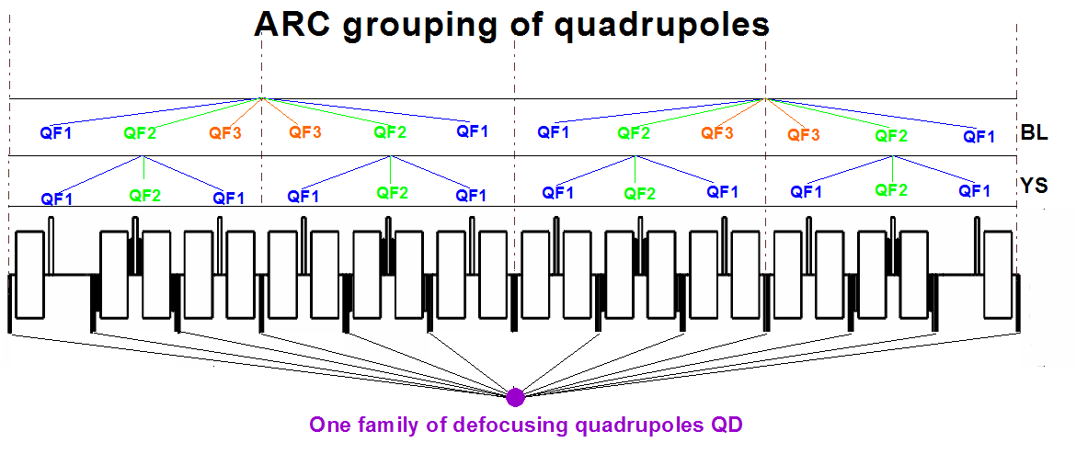
Two and four superperiodicity of arc
Two types of grouping:

Slide 4
Chromaticity correction and sextupole non-linear effect: number of sextupole families
Non-linear effect ~
Chromaticity suppressing

Slide 5
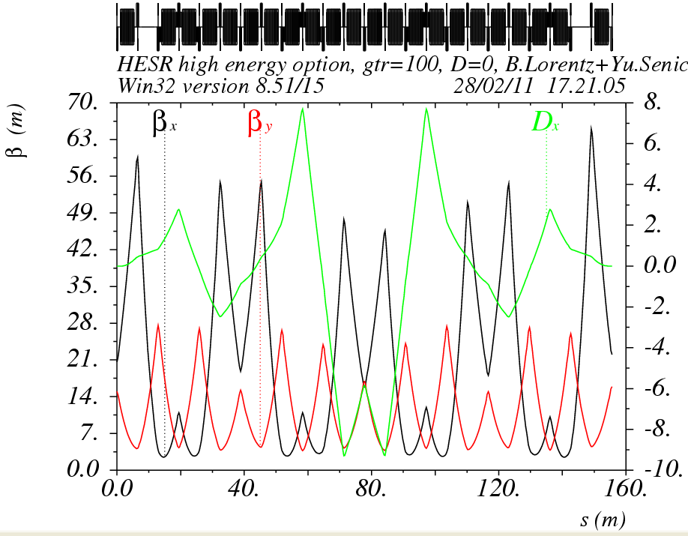
Chromaticity correction and sextupole non-linear effect: number of sextupole families

Slide 6
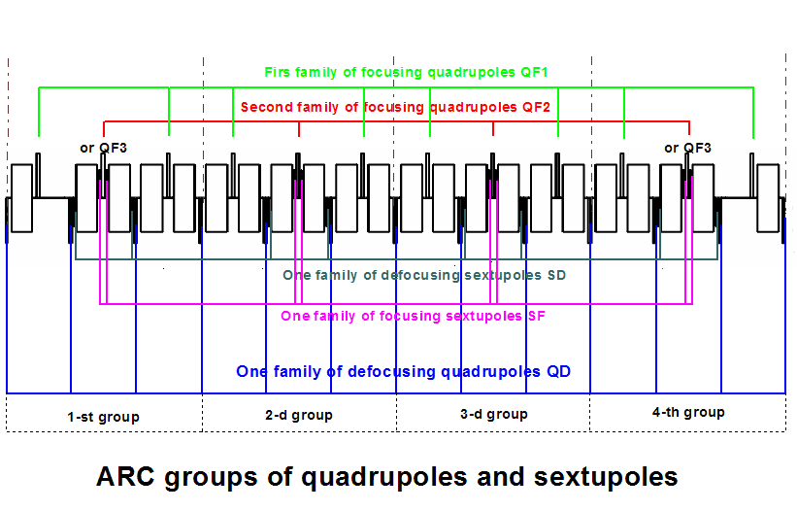
Transition energy: number of quadrupole families

Slide 7
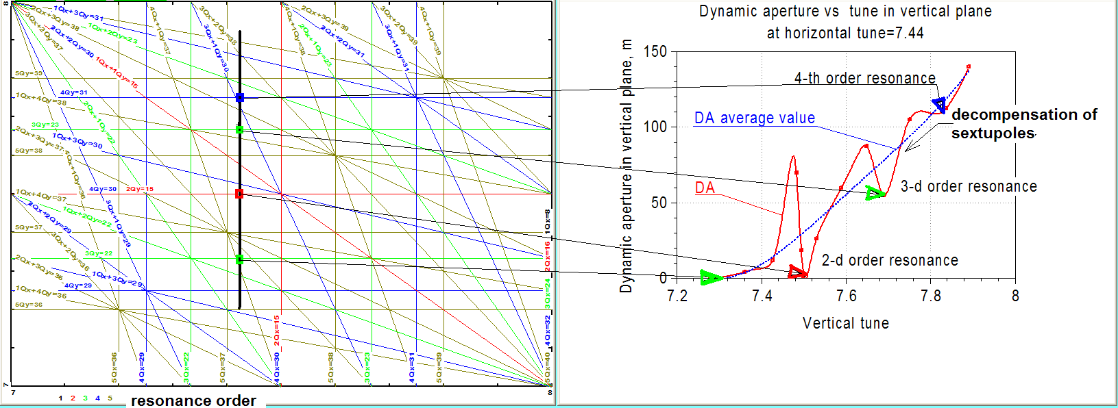
Chromaticity correction and sextupole non-linear effect: number of sextupole families
DA vs phase advance: at ν^{arc}_{x,y}→3.0 the cell tune →π/2 and DA grows

Slide 8
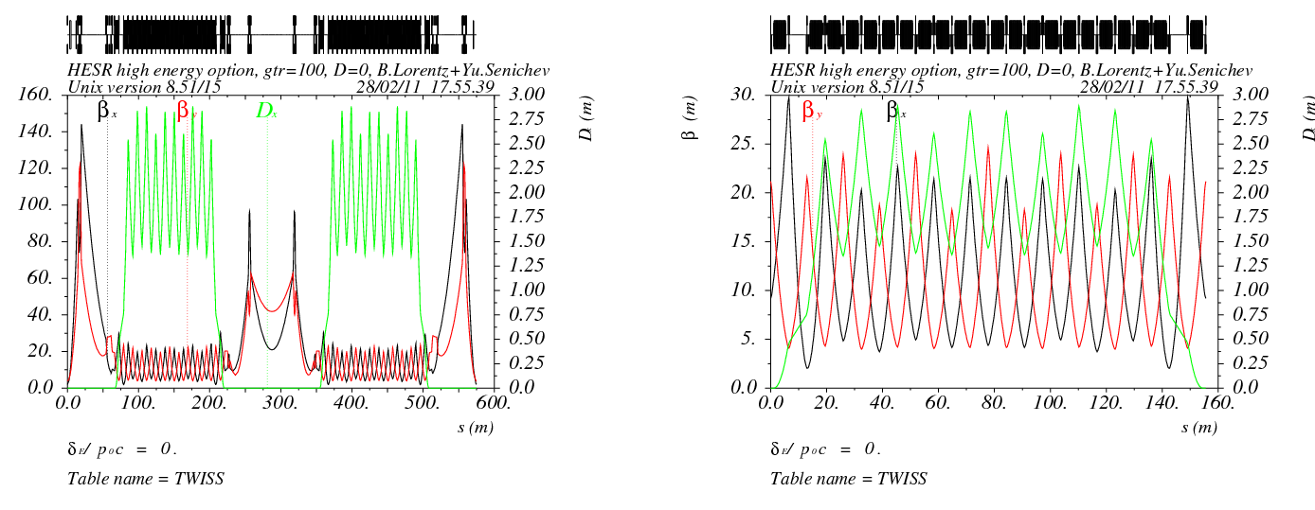
Low Transition Energy lattice
TWISS function:
RING ARC

Slide 9
DA for LTE option without errors >1000 mm mrad for both planes
Phys aperture is limited by the quadrupole aperture and equals
A_{x,y}=75/85 mm mrad

Slide 10
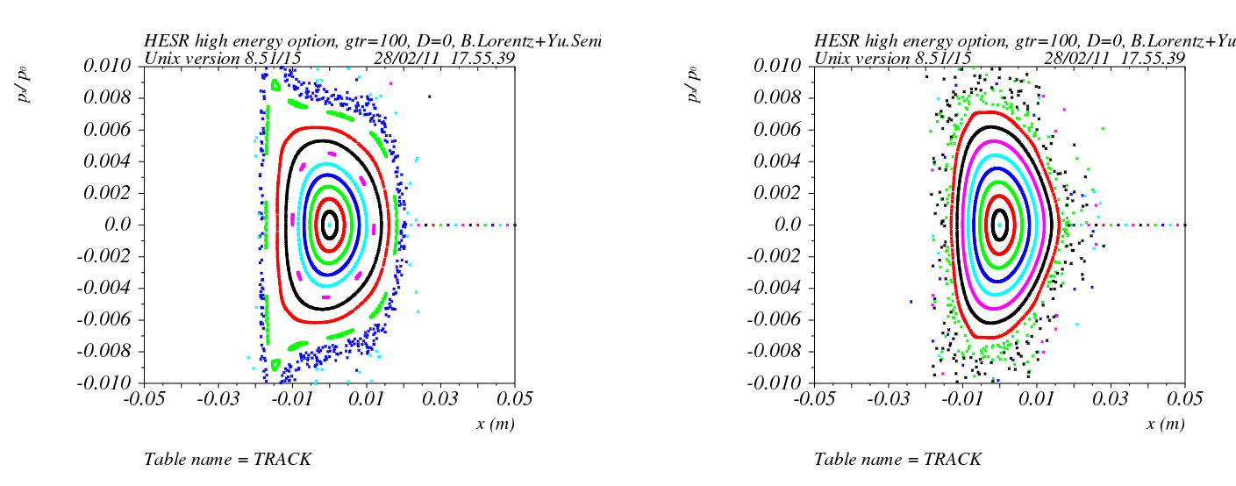
DA for LTE option with all errors >60 mm mrad for both planes
X plane dp/p=0.3%(a) X plane dp/p=0.0%(b)

Slide 11
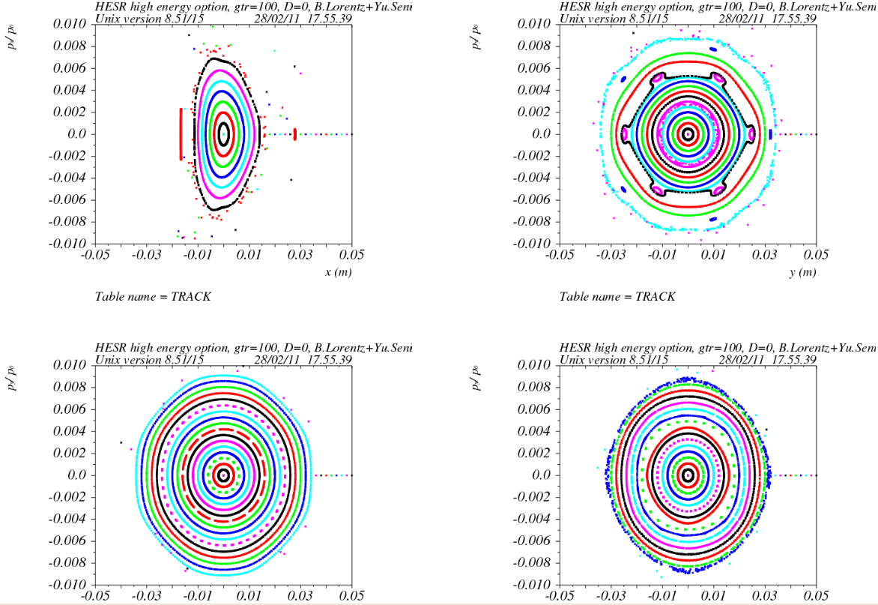
DA for LTE option with all errors >60 mm mrad for both planes
Figure: X plane dp/p=-0.3% (a); Y plane dp/p=0.3%;(b) 0.0%(c); -0.3%(d)

Slide 12
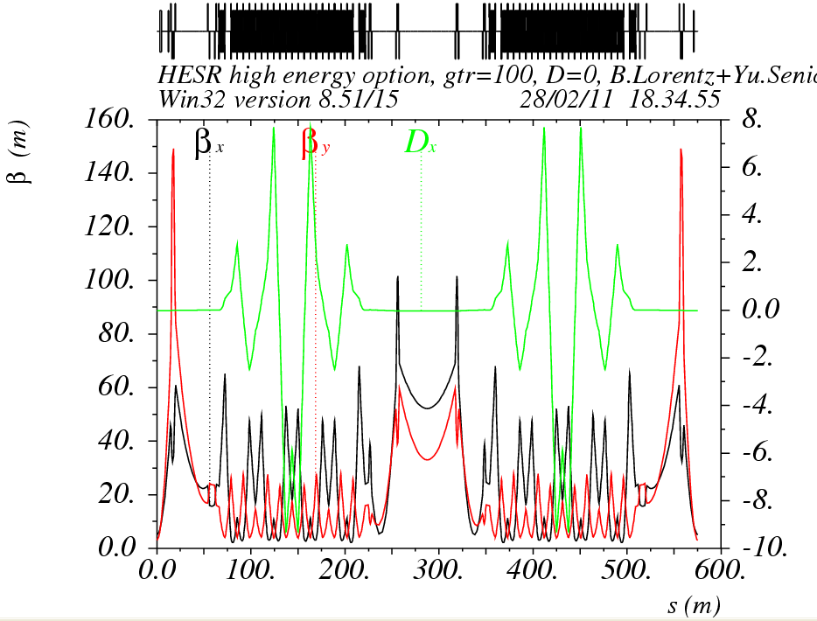
High Transition Energy (γ_{t}~i20) lattice
TWISS function

Slide 13
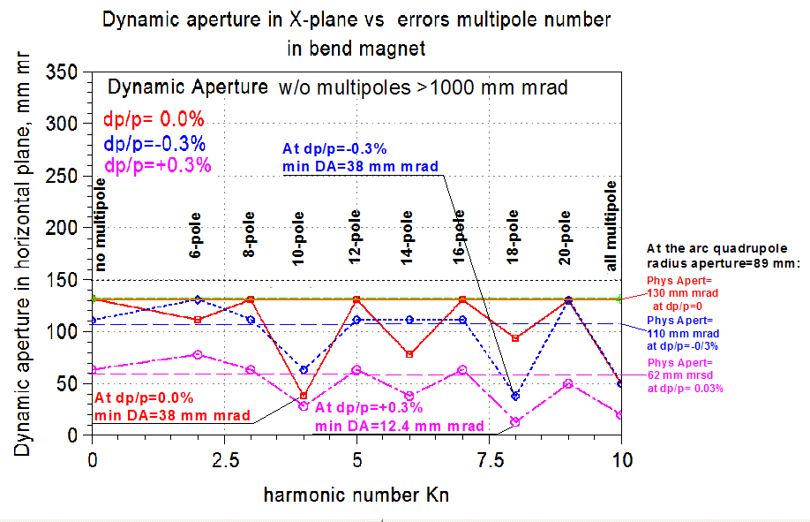
DA for HTE option with errors for monochromatic beam~40 mm mrad and at dp/p=±0.3% DA→10 mm mrad

Slide 14
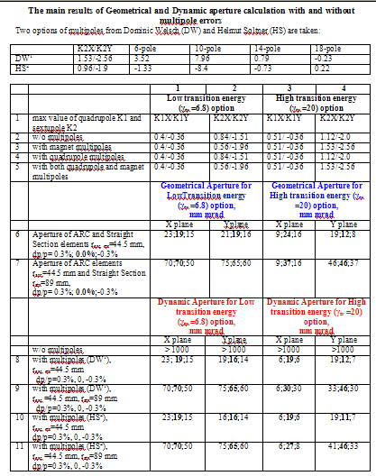
Table
1.

Slide 15
Conclusion
Influence of the chromatic sextupoles and the regular multipoles errors of bend magnets and quadrupoles has been investigated for two options, low and high energy lattices at two sets of multipole errors DW and HS.
Chromatic sextupoles practically do not influence on the dynamic aperture as it equals approximately 1000 mm mrad at value of the geometrical aperture of 10-20 mm mrad.
The maximum reduction of the geometrical aperture occurs because of the quadrupoles on the straight sections. It is confirmed by the fact that at an increase of the straight section quadrupoles aperture twice from 44.5 mm up to 89 mm the geometrical aperture increases by factor 2-4 (see 6-7 rows in table).
In the low energy option the multipole errors in bend and quadrupole magnets decrease the dynamic aperture up to value of 100-150 mm mrad. Therefore it is possible to say that they practically do not influence on the stability area, since the geometrical aperture is one order lower, and the restriction comes from the geometrical aperture.
In the high energy option the multipole errors squeeze the stability region up to the value smaller than the geometrical aperture.
The maximum influence of multipole errors are observed for non-monochromatic particles.
At multipole errors five times less for option γtr =20 and DW multipoles the Dynamic Aperture recovers up to Geometrical sizes and K2X/K2Y =1.2/-2.2

Slide 16
QFE2
QFE1
QF2
QF2
QF1
QF2
QF2
QF1
QF2
QF2
QFE1
QFE2
ES
QF2
QF1
QF2
QF2
QF1
QF2
QF2
QF1
QF2
QF2
QF1
QF2
AS
QD

Slide 17
Полностью Регулярная арка
Первое семейство фокусирующих квадруполей QF1
Второе семейство фокусирующих квадруполей QF2
Семейство фокусирующих секступолей SF
Семейство дефокусирующих секступолей SD

Slide 18
Полностью Регулярная арка (eng)
1st focusing family QF1
2nd focusing family QF2
Focusing sextupole family SF
Defocusing sextupole family SD

Slide 19
неРегулярная арка с подавлением крайними ячейками
Первое семейство фокусирующих квадруполей QF1
Второе семейство фокусирующих квадруполей QF2
QFE2
QFE1
QFE1
QFE2
Семейство фокусирующих секступолей SF
Семейство дефокусирующих секступолей SD

Slide 20
неРегулярная арка с подавлением всей аркой
Первое семейство фокусирующих квадруполей QF1
Второе семейство фокусирующих квадруполей QF2
Семейство фокусирующих секступолей SF
Семейство дефокусирующих секступолей SD
Нет секступолей

Slide 21
EDGE SUPPRESSOR
1st focusing family QF1
2nd focusing family QF2
QFE2
QFE1
QFE1
QFE2
Focusing sextupole family SF
Defocusing sextupole family SD

Slide 22
ARC SUPPRESSION
1st focusing family QF1
2nd focusing family QF2
Focusing sextupole family SF
Defocusing sextupole family SD
No sextupoles

Slide 23
ION MODE
Focusing family
QFE2
QFE1
QFE1
QFE2
Focusing sextupole family SF
Defocusing sextupole family SD

Slide 24
QF2
QF1
QF2
суперпериод
магнит
QD
QD
QD
QD
1-я ячейка
2-я ячейка
3-я ячейка

Slide 25
QF2
QF1
QF2
superperiod
magnet
QD
QD
QD
QD
1st cell
2nd cell
3d cell

Slide 26
QF2
QF1
QF2
superperiod
magnet
QD
QD
QD
QD
1st cell
2nd cell
3^{d} cell

Slide 27
1st focusing family QF1
2nd focusing family QF2
or QFE2
or QFE1
or QFE1
or QFE2
Defocusing sextupole family SD
Focusing sextupole family SF

Slide 28
4 суперпериода
Регулярная арка
D,D’=0
D,D’=0
3 ФОДО
3 ФОДО
3 ФОДО
3 ФОДО
4 superperiod
Regular arc
D,D’=0
D,D’=0
3 FODO
3 FODO
3 FODO
3 FODO

Slide 29
Подавление дисперсии крайними ячейками
missing magnet
missing magnet
D,D’=0
D,D’=0
3 ФОДО
3 ФОДО
3 ФОДО
3 ФОДО
Подавление 2 ячейками
Подавление дисперсии 2 семействами
D,D’=0
missing magnet
missing magnet
D,D’=0
3 ФОДО
3 ФОДО
3 ФОДО
3 ФОДО

Slide 30
Suppression
by edge cells
missing magnet
missing magnet
D,D’=0
D,D’=0
3 FODO
3 FODO
3 FODO
3 FODO
2 FODO cells suppressor
Suppression
by two families
D,D’=0
missing magnet
missing magnet
D,D’=0
3 FODO
3 FODO
3 FODO
3 FODO

Slide 31
Dispersion suppression with edge cells
D,D’=0
D,D’=0
3 cells
3 cells
3 cells
3 cells
Suppressor 2 cells
Dispersion suppression with 2 family
D,D’=0
D,D’=0
3 cells
3 cells
3 cells
3 cells

Slide 32
Dispersion suppression with edge cells
D,D’=0
D,D’=0
3 cells
3 cells
3 cells
3 cells
Suppressor 2 cells
Dispersion suppression with 2 family
D,D’=0
D,D’=0
3 cells
3 cells
3 cells
3 cells
D,D’=0
FODO
FODO
D,D’=0
Suppressor 2 cells

